Slide 1

FoodHub.sg
By: Andrea, Megan, Vignesh, Zafirah

Slide 2
User Stories
A busy adult who tries to break out of their sedentary lifestyle by exercising and dieting but quits calorie counting because it seemed like a lot of time and effort to track, so they stuck to just exercising but isn’t seeing the expected difference in their BMI. As a result, they are close to quitting pursuing a healthy lifestyle altogether and becoming sedentary again.
A new mother who’s trying to get back into shape but finds exercising to be hard due to the strain child birth put on her body. She tries to diet using a dieting app but isn’t seeing a big difference because dieting apps just predict the amount of calories the user is intaking and unfortunately, the app guessed wrong most of the time resulting in the mother intaking a higher amount of calories than she should.

Slide 3
User Stories
A teenager who tries dieting but ends up giving up because of the daunting amount of variables to keep track of. She now faces the risk of having several morbid health conditions.
A person who works during the night, who snacks often while he is working. Due to the addictive nature of those snacks, he often intakes more than thousands of calories without even realising it! He wants an easy way to track whatever he eats accurately.
A super fan obsessed with a K-pop group who’s trying to follow their unnatural body standards. He has resorted to using diet pills, fast weight loss diet plans without researching them. Hoping to achieve his ideal body, he ends up getting admitted to a hospital because of how ill-suited the diet plan was to his body.

Slide 4
“What diet plans suit me?“
“There are so many things to keep track of in dieting properly.”
“How many kg do I need to lose?”
“I lead an unhealthy lifestyle.”
“What is the most efficient way for me to lose weight? How can I maintain it?”
“I want to get into dieting but I just don’t know where to start. ”
“I feel like I could be healthier.”
“There’s just so many options out there that it’s kinda intimidating.”
Worried as he thinks about
the health implications of not looking at his weight
Inferior as he feels he does not look good compared to his peers.
Overwhelmed by the number of diet plans out there.
Think
Casey, the overweight teenager.
Say
Casey
Feel
Do
He needs to find healthy ways to lose weight.
He needs to monitor his calorie intake for a day to keep him from going back to eating unhealthy foods.
He needs to keep his morale up to continue with his diet plan.

Slide 5
Problem Statement
Controlling food portions is a major part of leading a healthy lifestyle. However, many young adults find this a daunting task due to the sheer amount of variables they must keep track of. Because of this a high amount of people quit dieting or worse, get the wrong idea and inadvertently develop serious eating disorders like anorexia.
Therefore, we propose a system integrated into major food vendors to remove the guesswork out of portion control by giving the user an app to keep track of exactly how much they ate, down to the calorie while suggesting diet plans that would best suit them.

Slide 6
Features
BMI Chart
This compares their BMI over a period of time. This will encourage users to get healthy as long as they want to.
Codes from food items
To keep track of the total calories consumed by the user each time they eat something
Diet Plans
The user enters their BMI and they will be automatically allocated a diet plan. The app will simply suggest food that falls under this. We do this to reduce confusion.
Rating System
Rating according to how healthy the menu is of a particular store.
Food Vendors Suggestions
To suggest food items from restaurants near the user’s vicinity that suits their diet plan
Instructing users on where to start
The app will suggest the user general tips and pointers to get them started on pursuing a healthy lifestyle.

Slide 7
Prototype

Slide 8
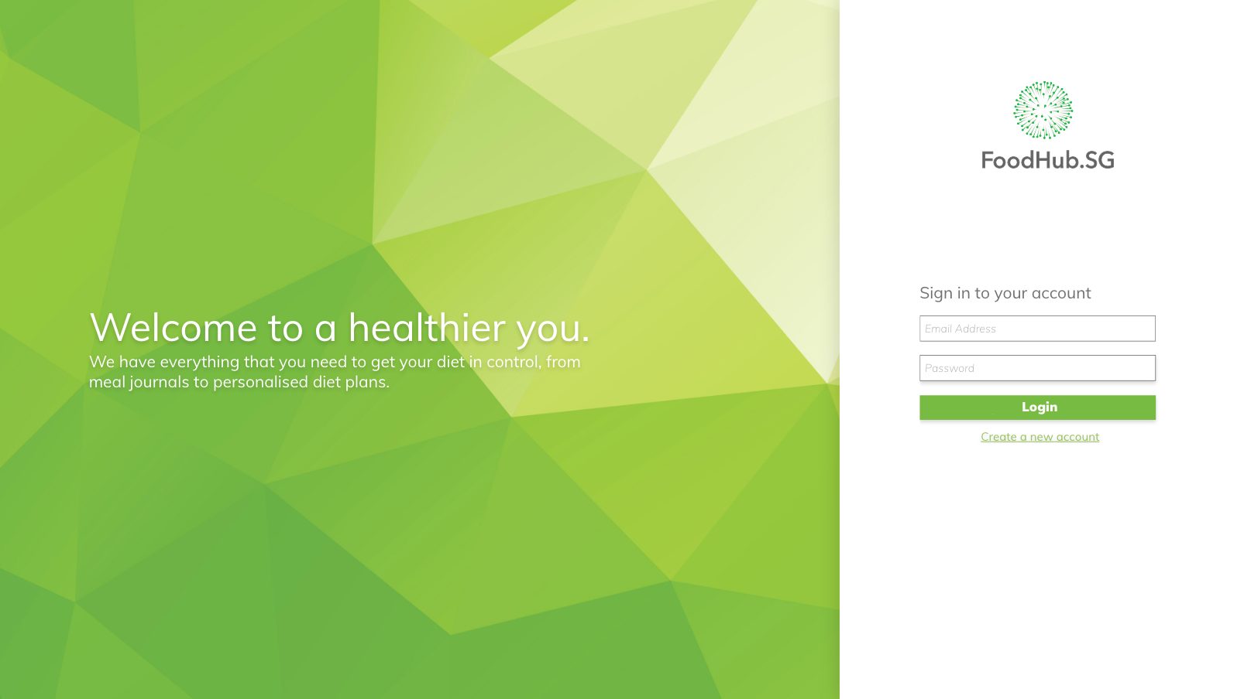

Slide 9
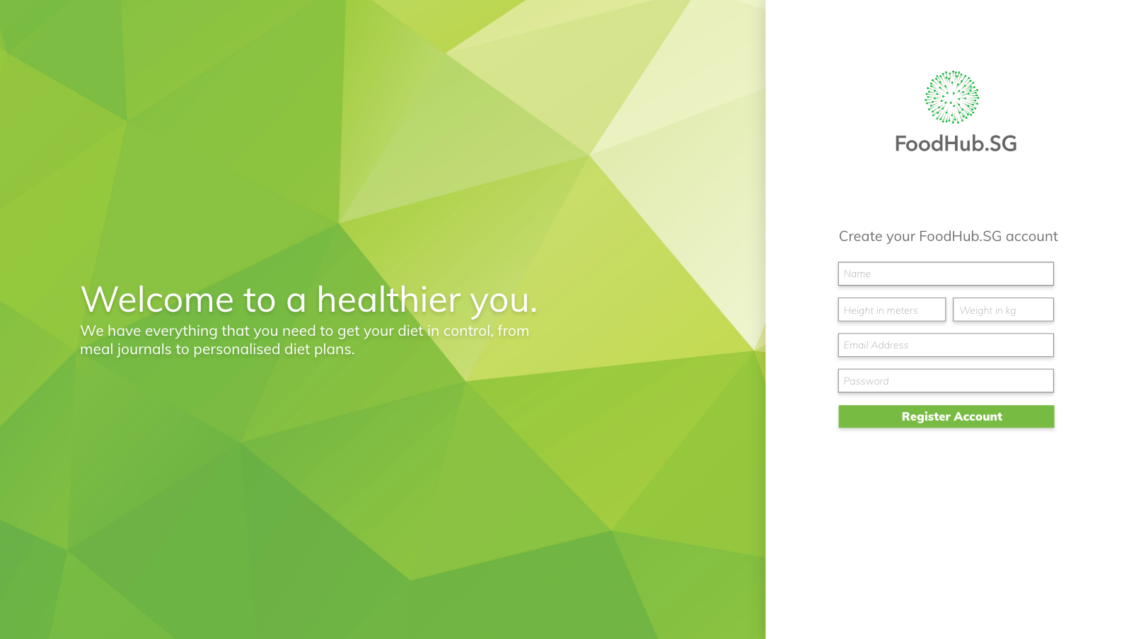

Slide 10
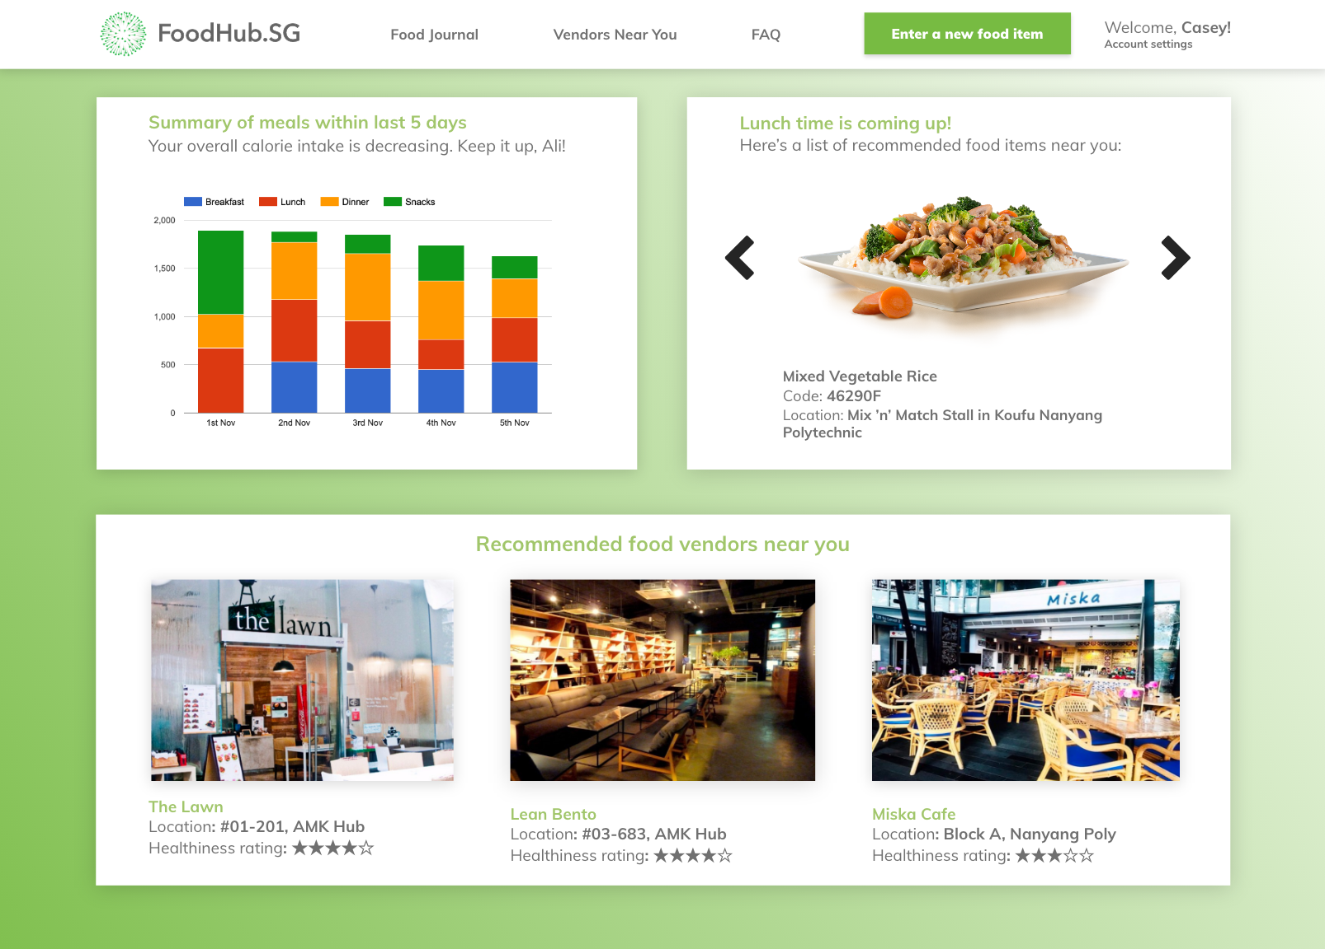

Slide 11
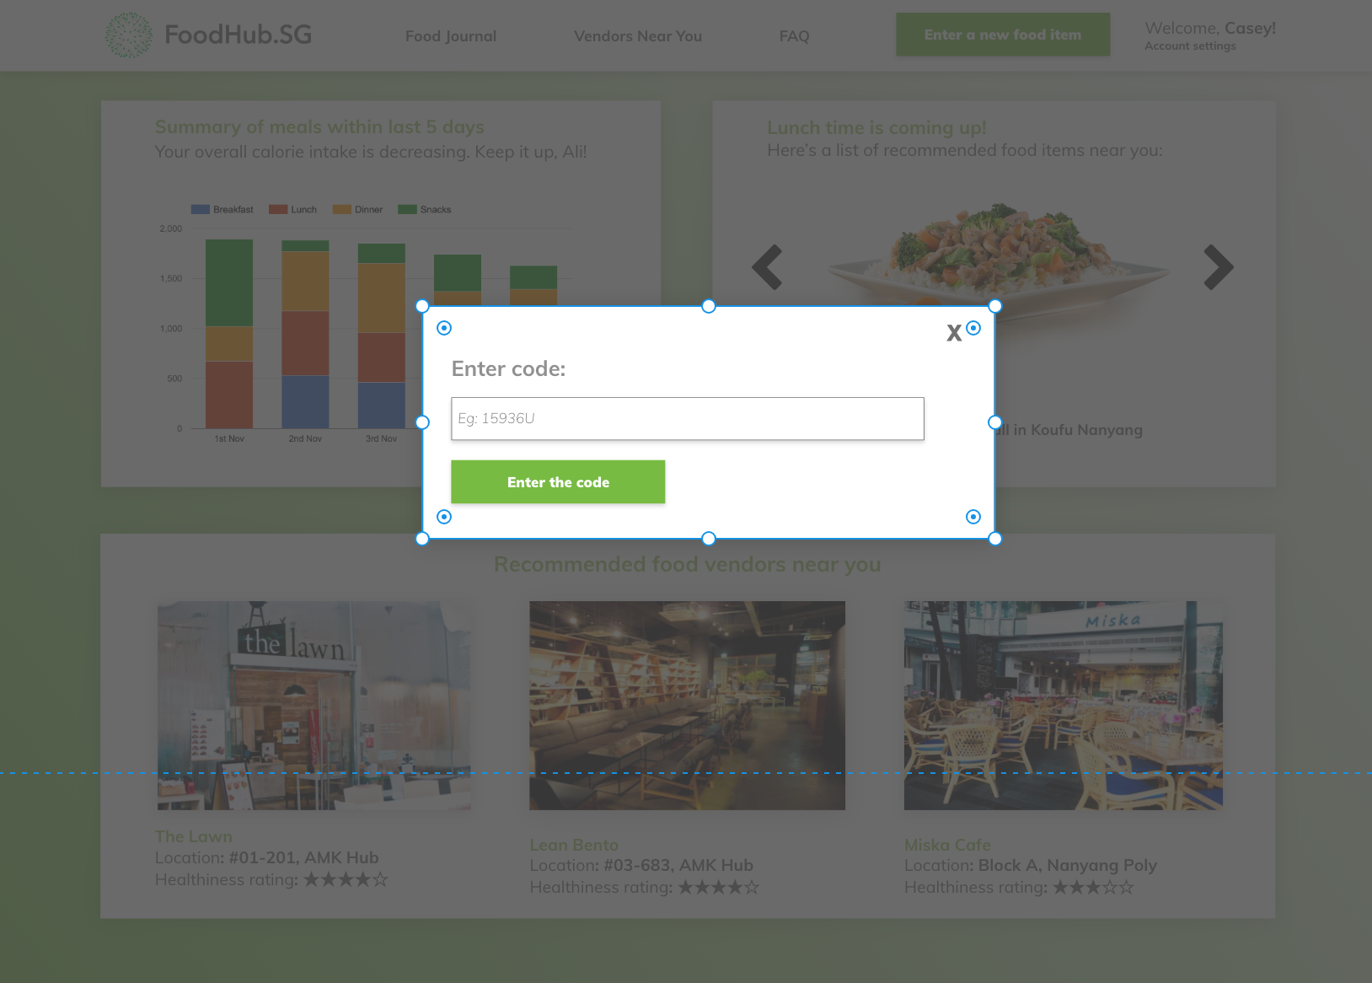

Slide 12
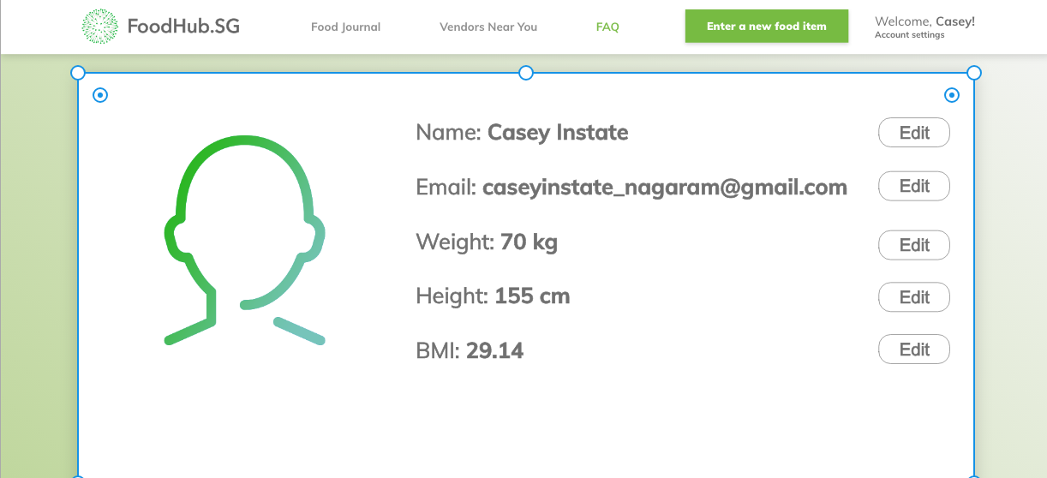

Slide 13
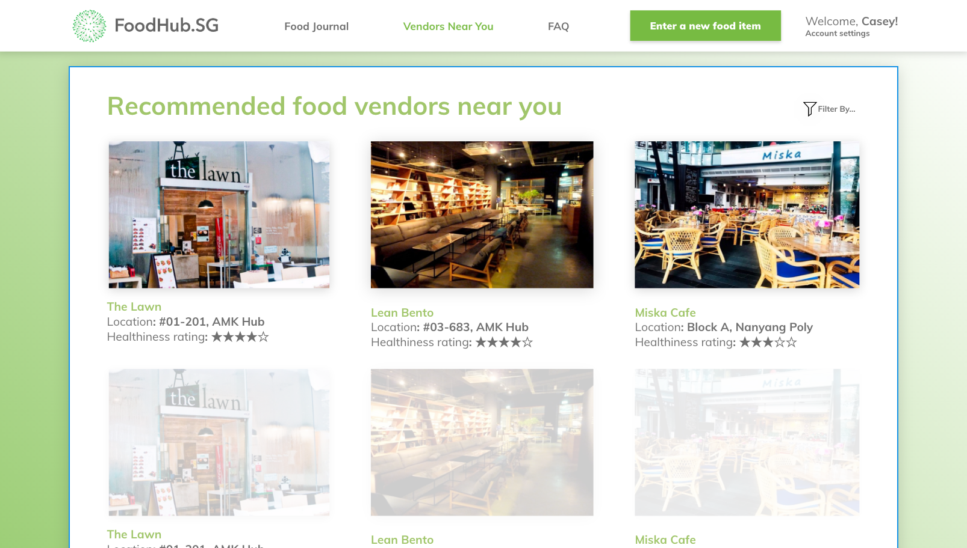

Slide 14
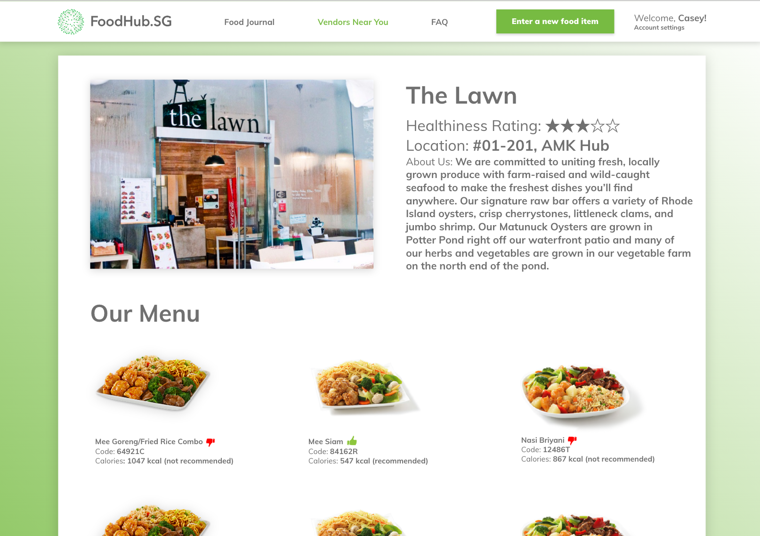

Slide 15
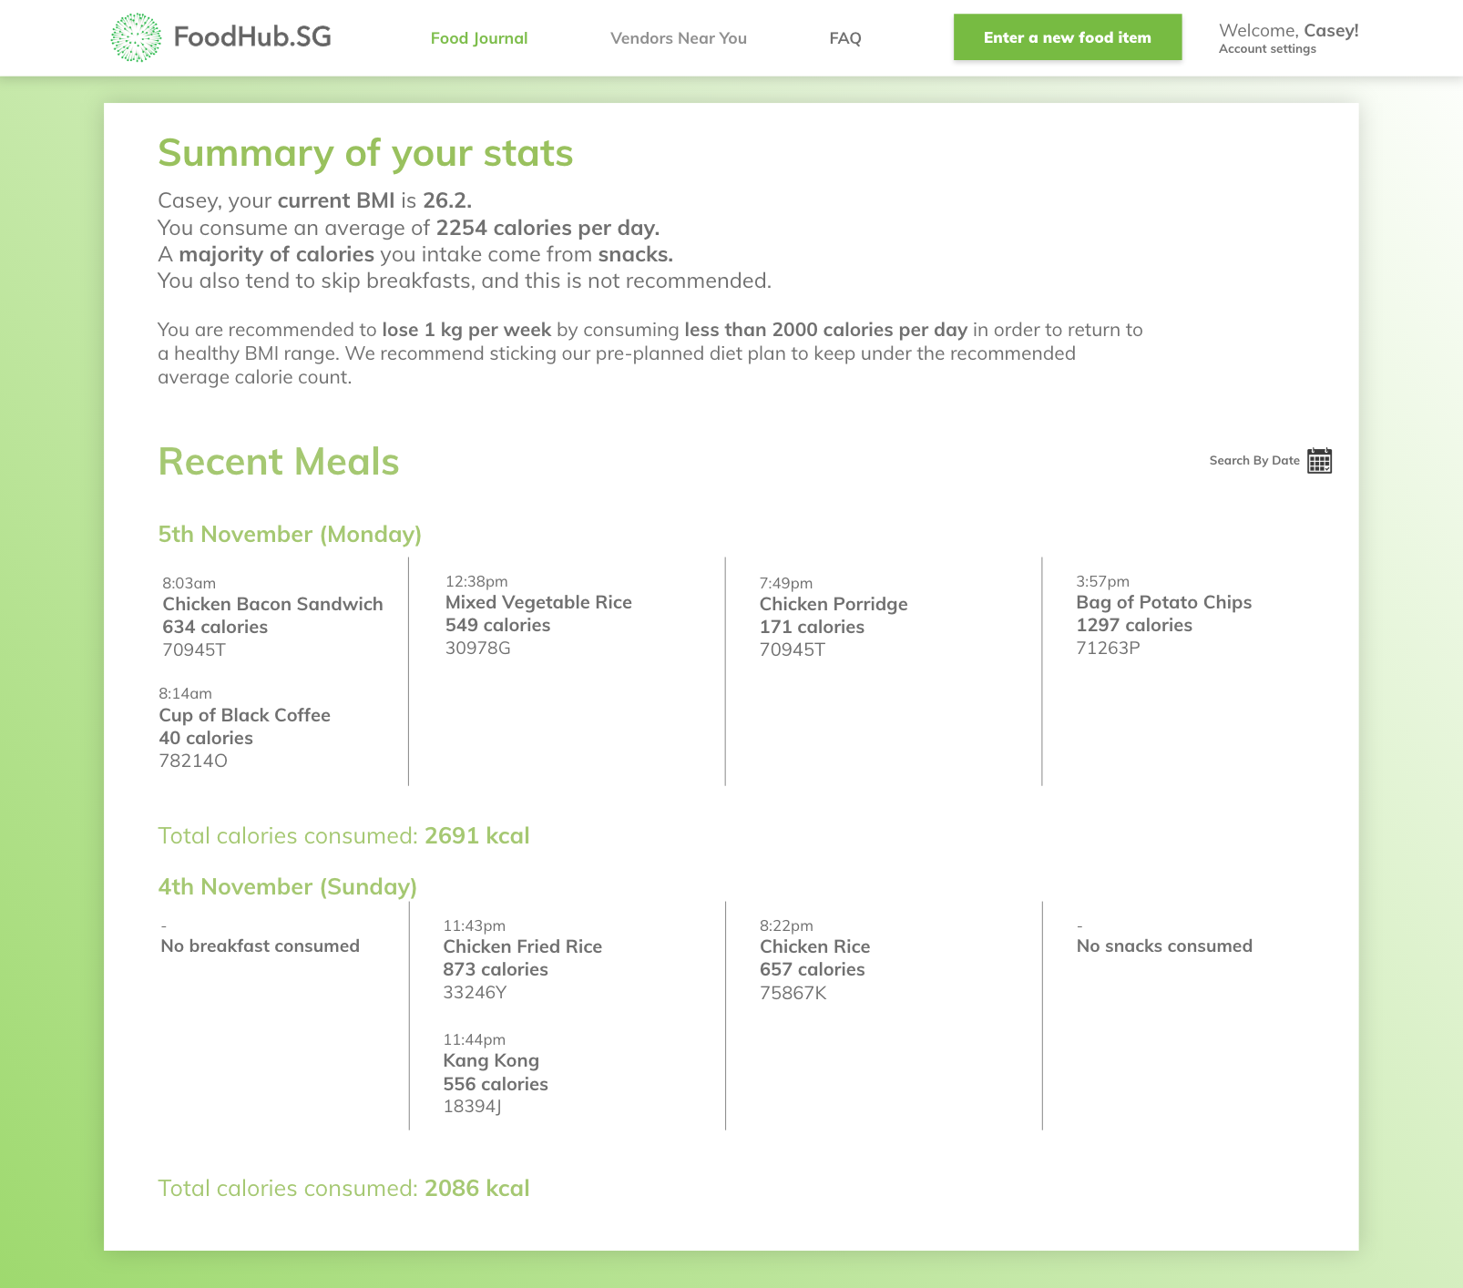

Slide 16
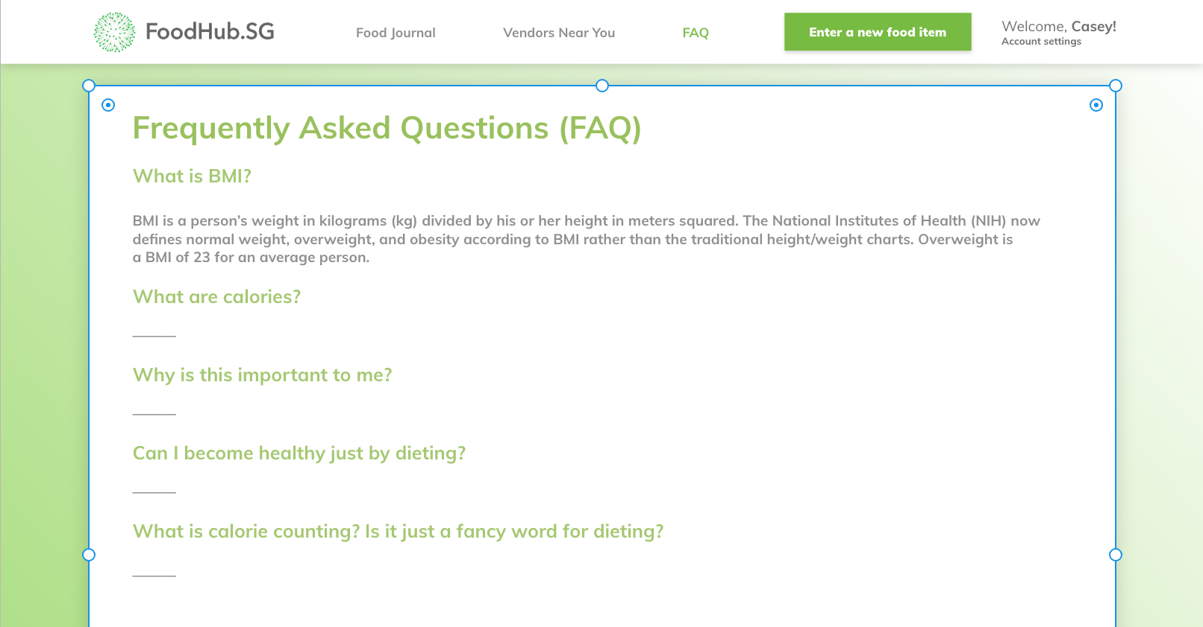

Slide 17
Thank you!

